Slide 1
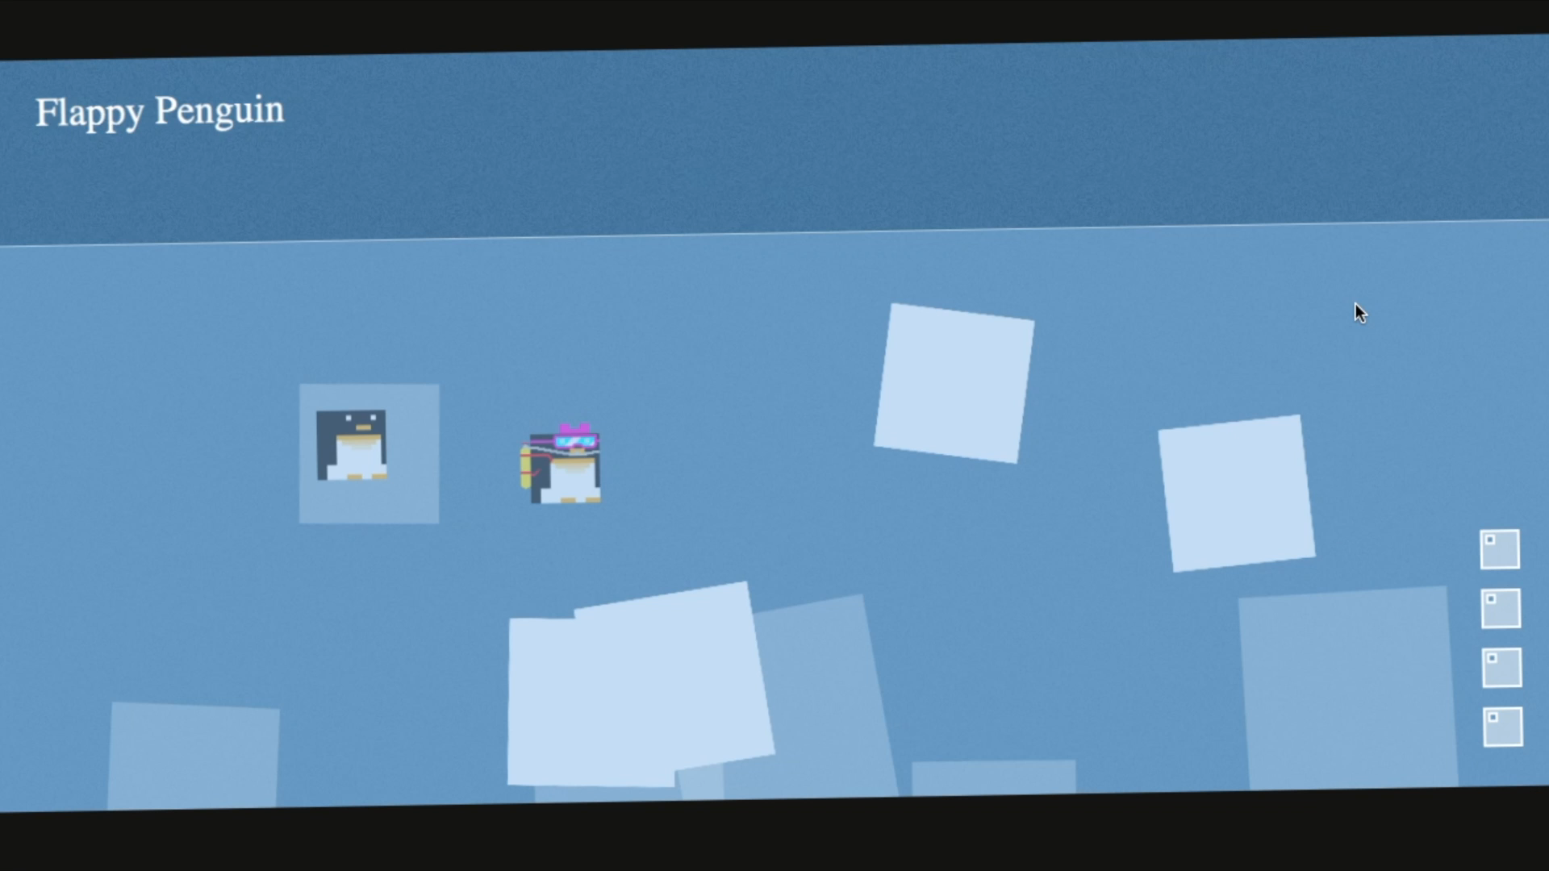

Slide 2


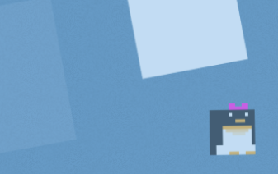


Flappy Penguin
HCI Final Project
Gernot Brunner - Stefan Cimander - Martin Hartmond - Thomas Weber

Slide 3


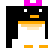
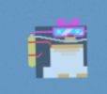
Game Concept
Don’t crash with an Ice Block!

Slide 4
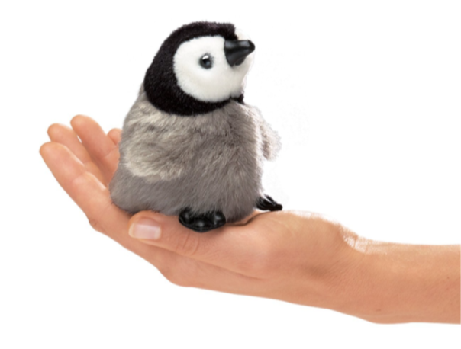
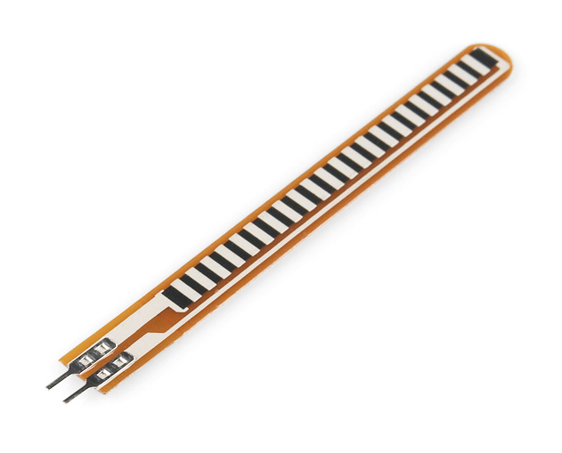
Physical Computing
Integrating Flex Sensor into Penguin Plush Toy

Slide 5
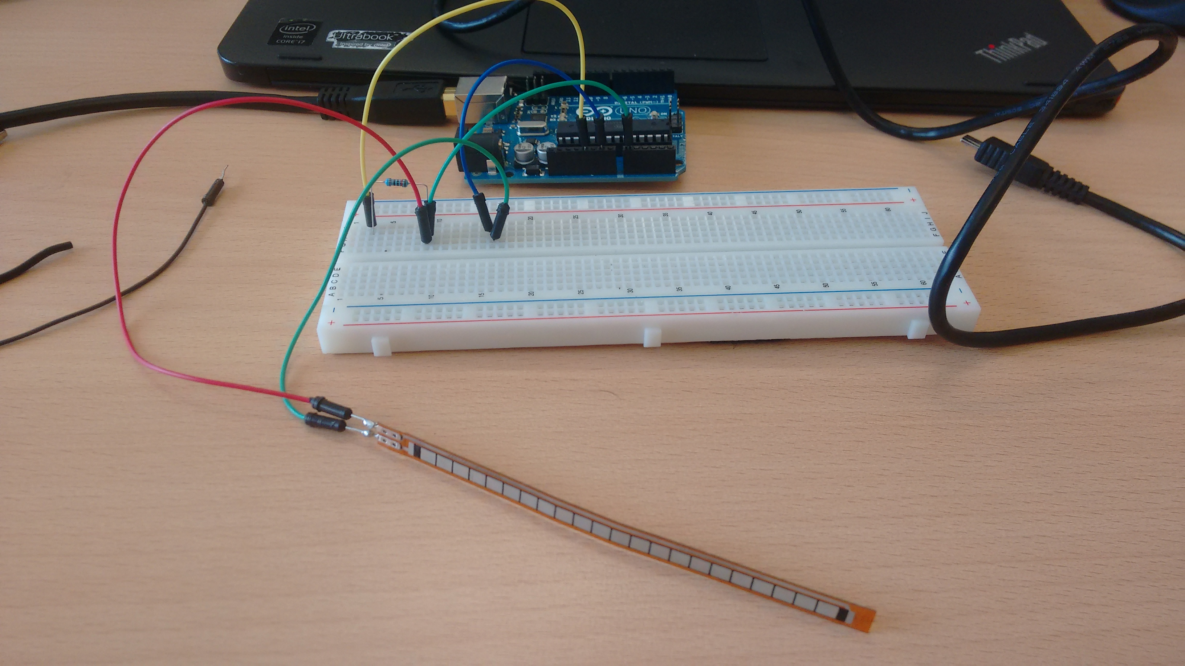
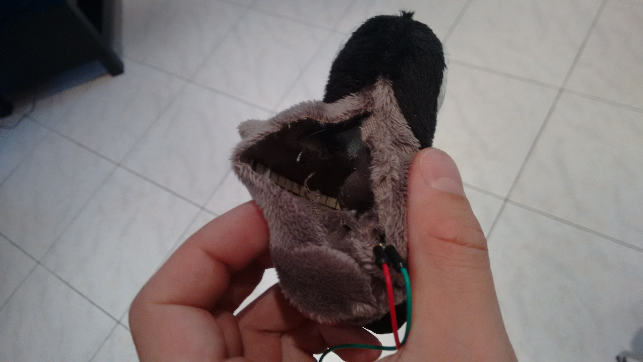
Input Device
Integrating Flex Sensor into Penguin Plush Toy

Slide 6
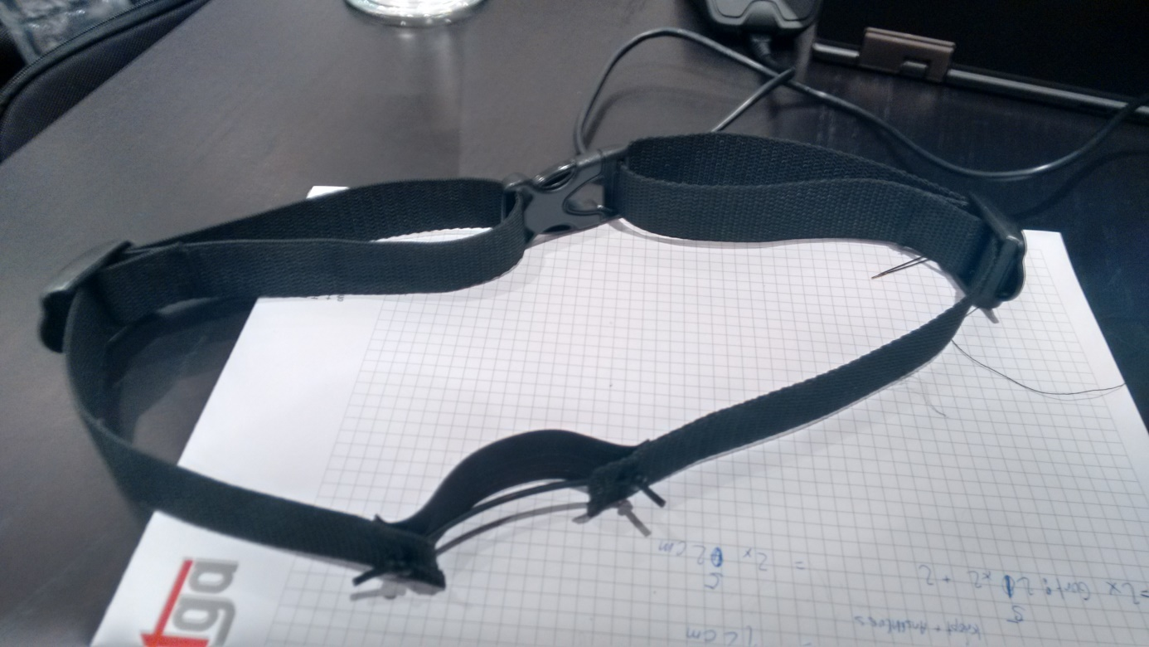
Breathing-Sensor
Using Stretch Sensor for Breath Recognition

Slide 7


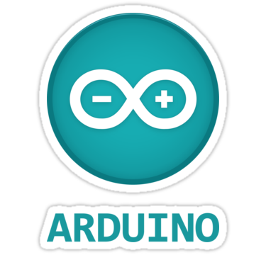


Software Stack
Backend
Frontend
Synchronous Rendering Pipeline
Detected User Actions
Asynchronous Callbacks
Sensor Input
Enemy AI
Q-Learning

Slide 8
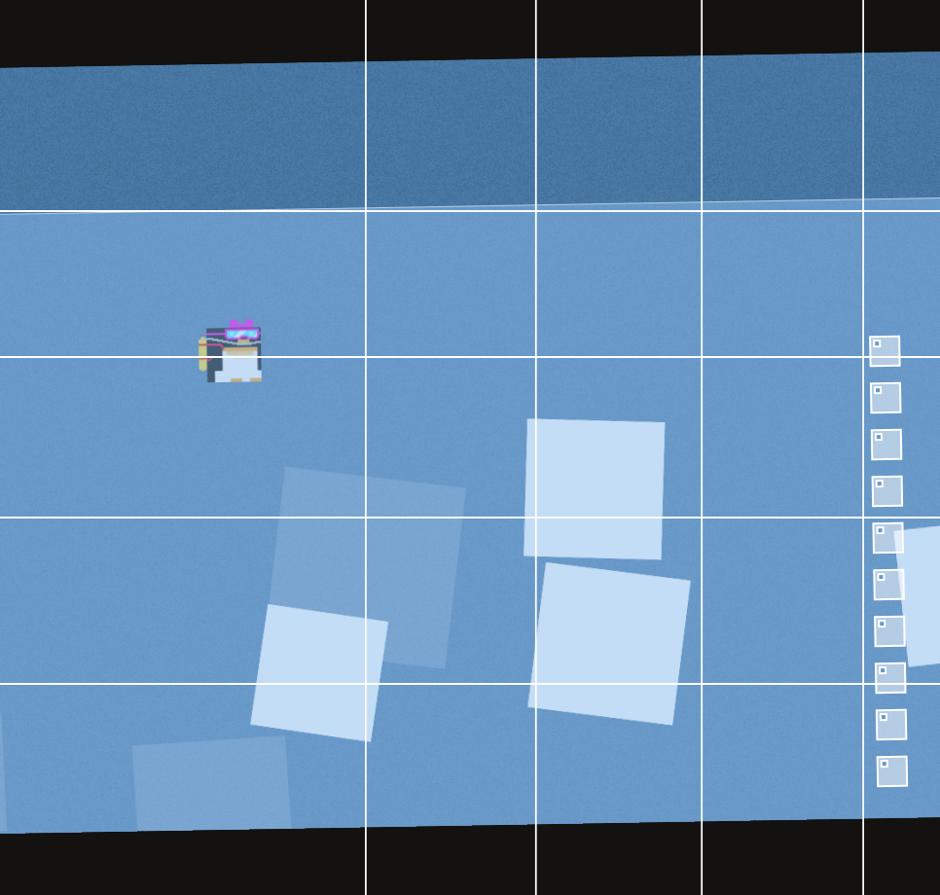
Q-Learning
Q-Table is a JavaScript Object
State is key-type, i.e. Int or String
Challenge: Encode game state as <32bit Integer

Slide 9

Q-Learning
Discretize Space in front of the penguin in n (<32) sample points
Encode obstacle or ¬obstacle bitwise
0001 0011 0000 0000

Slide 10

Q-Learning
Append n bits: Discretized penguin position
e.g. Penguin 10 (= 0000 1010) Units from top
0001 0011 0000 0000 0000 1010

Slide 11
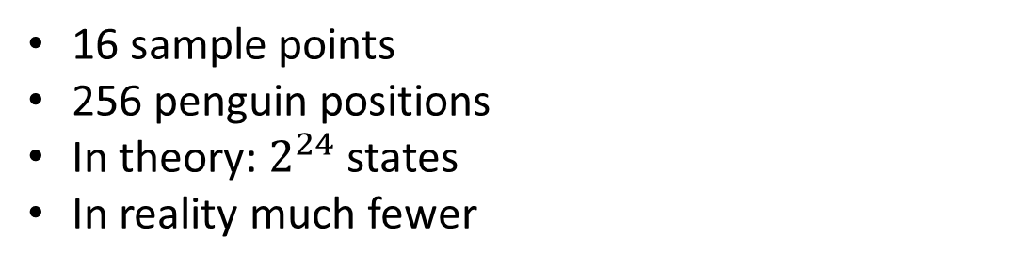
Q-Learning
16 sample points
256 penguin positions
In theory: $2^{24}$ states
In reality much fewer

Slide 12
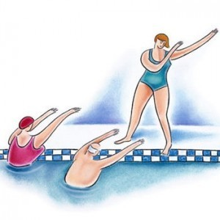

Outlook
Relaxing Exercises
Water gymnastics
What would be a other Scenarios for Flappy Penguin?

Slide 13
Demo
Flappy Penguin

